Slide 1
Classification - Machine Learning

Slide 2
Classification: Meaning
Classification is a type of supervised learning. It specifies the class to which data elements belong to and is best used when the output has finite and discrete values. It predicts a class for an input variable as well.
There are 2 types of Classification:
• Binomial
• Multi-Class

Slide 3
Some of the key areas where classification cases are being used:
• To find whether an email received is a spam or ham
• To identify customer segments
• To find if a bank loan is granted
• To identify if a kid will pass or fail in an examination

Slide 4
Types of Classification Algorithms
Let’s have a quick look into the types of Classification Algorithm below.
• Linear Models
o Logistic Regression
o Support Vector Machines
• Nonlinear models
o K-nearest Neighbors (KNN)
o Kernel Support Vector Machines (SVM)
o Naïve Bayes
o Decision Tree Classification
o Random Forest Classification

Slide 5
Logistic Regression: Meaning
Let us understand the Logistic Regression model below.
This refers to a regression model that is used for classification.
This method is widely used for binary classification problems. It can also be extended to multi-class classification problems.
Here, the dependent variable is categorical: y ϵ {0, 1}
A binary dependent variable can have only two values, like 0 or 1, win or lose, pass or fail, healthy or sick, etc
In this case, you model the probability distribution of output y as 1 or 0. This is called the sigmoid probability (σ).
If σ(θ Tx) > 0.5, set y = 1, else set y = 0
Unlike Linear Regression (and its Normal Equation solution), there is no closed form solution for finding optimal weights of Logistic Regression. Instead, you must solve this with maximum likelihood estimation (a probability model to detect the maximum likelihood of something happening).
It can be used to calculate the probability of a given outcome in a binary model, like the probability of being classified as sick or passing an exam.

Slide 6
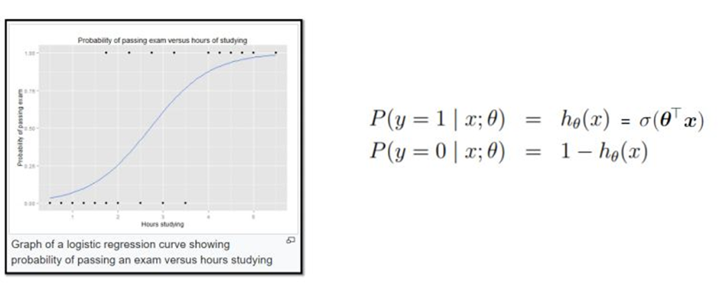

Slide 7
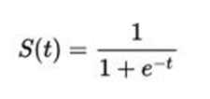
The probability in the logistic regression is often represented by the Sigmoid function (also called the logistic function or the S-curve):
• In this equation, t represents data values * the number of hours studied and S(t) represents the probability of passing the exam.

Slide 8
Regularization in Logistic Regression
Regularization is extremely important in logistic regression modeling. Without regularization, the asymptotic nature of logistic regression would keep driving loss towards 0 in high dimensions. Consequently, most logistic regression models use one of the following two strategies to dampen model complexity:
L2 regularization.
Early stopping, that is, limiting the number of training steps or the learning rate.

Slide 9
Logistic regression classifier and how regularization affects the performance of the classifier.
Training a machine learning algorithms involves optimization techniques.However apart from providing good accuracy on training and validation data sets ,it is required the machine learning to have good generalization accuracy.The machine learning algorithms should perform well on unseen examples as well.The model is trained by optimizing its performance over some training dataset however its performance is determined on its ability to perform on unseen datasets.

Slide 10
Overfitting
The term over fitting is often used when machine learning algorithm has high accuracy on training data set but poor generalization accuracy.

Slide 11
Problem of Overfitting
Over-fitting generally occurs when a model is excessively complex.A model that has been overfit will generally have poor generalization capabilities , as it can perform errors due to minor fluctuations in data dues to noise and other parameters which were not modeled during the training process.
Just because a model agrees with training data does not mean it will perform well on unseen examples and is not necessarily a good model.In case of overfitting the model just tries to learn pecularities of the training set and does not work well on unseen examples that differ from the training set.
In general over-fitting can be associated with complexity.

Slide 12
Training,Validation and Testing Datasets
Typically we can get some idea as to if over-fitting has been performed on not by periodically testing the model on unseen test data set.Thus during the training process we make use of 3 types of data sets.
Training data set that is primarily used for learning.
The validation data set which is a part of training data set but not used during the learning and
test data set that contains a large variations of typically input data that represents all possible unseen examples.
The validation data set is the unseen data set against when we can test the model to check for over-fitting and generalization performance.The learning algorithm has not seen the samples from the validation data set.Validation data sets is used to test the various choices of the model parameters .Thus validation data set which is again considered a part of training dataset is used to periodically evaluate the model parameters.Based on the performance of the model we decide if over-fitting has occurred,learning process has been saturated and possibly adaptively tune the model.
The difference between validation data set and test data set is that validation data set is not as challenging as the test data set.It contains unseen examples but may not contain a large variation or all possible end cases or difficult examples.
The test data is primarily used to check if the model truly performs as expected agains a large variation in data.That is why the test data set is supposed to contains samples with large variations in data and difficult and end cases ,which are not included in the training data .If we use test data directly for validation purpose we may bias the classifier to overfit or choose parameters according to the test data ,which is again undesirable for the sake of generality

Slide 13
how to handle the cases of overfitting
Increasing size of dataset
Early stopping
Regularization
A way to combat over-fitting is through regularization. Regularization techniques can be viewed as imposing certain prior distribution on the model parameters.Mathematically the regularization process implies performing constrained optimization.

Slide 14
Decision Tree Classifier
Some aspects of the Decision Tree Classifier mentioned below are.
• Decision Trees (DT) can be used both for classification and regression.
• The advantage of decision trees is that they require very little data preparation.
• They do not require feature scaling or centering at all.
• They are also the fundamental components of Random Forests, one of the most powerful ML algorithms.
• Unlike Random Forests and Neural Networks (which do black-box modeling), Decision Trees are white box models, which means that inner workings of these models are clearly understood.
• In the case of classification, the data is segregated based on a series of questions.
• Any new data point is assigned to the selected leaf node

Slide 15
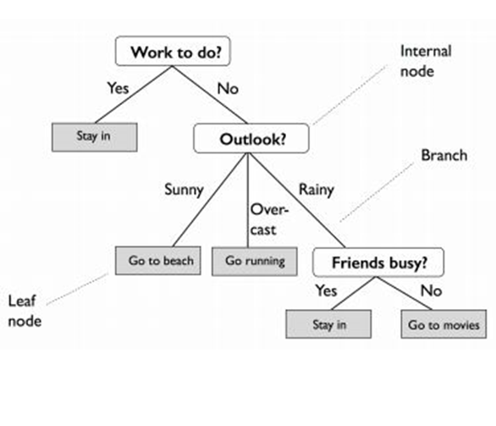

Slide 16
• Start at the tree root and split the data on the feature using the decision algorithm, resulting in the largest information gain (IG).
• This splitting procedure is then repeated in an iterative process at each child node until the leaves are pure.
• This means that the samples at each node belonging to the same class.
• In practice, you can set a limit on the depth of the tree to prevent overfitting.
• The purity is compromised here as the final leaves may still have some impurity.

Slide 17
Key Takeaways
Let us quickly run through what we have learned so far in this Classification tutorial.
• Classification algorithms are supervised learning methods to split data into classes. They can work on Linear Data as well as Nonlinear Data.
• Logistic Regression can classify data based on weighted parameters and sigmoid conversion to calculate the probability of classes. K- nearest Neighbors (KNN) algorithm uses similar features to classify data.
• Decision Trees are powerful classifiers and use tree splitting logic until pure or somewhat pure leaf node classes are attained.

Slide 18
What is Boosting?
Definition:
The term ‘Boosting’ refers to a family of algorithms which converts weak learner to strong learners.

Slide 19
Let’s understand this definition in detail by solving a problem of spam email identification:
How would you classify an email as SPAM or not? Like everyone else, our initial approach would be to identify ‘spam’ and ‘not spam’ emails using following criteria. If:
1. Email has only one image file (promotional image), It’s a SPAM
2. Email has only link(s), It’s a SPAM
3. Email body consist of sentence like “You won a prize money of $ xxxxxx”, It’s a SPAM
4. Email from our official domain “Analyticsvidhya.com” , Not a SPAM
5. Email from known source, Not a SPAM

Slide 20
Above, we’ve defined multiple rules to classify an email into ‘spam’ or ‘not spam’. But, do you think these rules individually are strong enough to successfully classify an email? No.
Individually, these rules are not powerful enough to classify an email into ‘spam’ or ‘not spam’. Therefore, these rules are called as weak learner.
To convert weak learner to strong learner, we’ll combine the prediction of each weak learner using methods like:
• Using average/ weighted average
• Considering prediction has higher vote
For example: Above, we have defined 5 weak learners. Out of these 5, 3 are voted as ‘SPAM’ and 2 are voted as ‘Not a SPAM’. In this case, by default, we’ll consider an email as SPAM because we have higher(3) vote for ‘SPAM’.

Slide 21
How Boosting Algorithms works
Now we know that, boosting combines weak learner a.k.a. base learner to form a strong rule. An immediate question which should pop in your mind is, ‘How boosting identify weak rules?‘
To find weak rule, we apply base learning (ML) algorithms with a different distribution. Each time base learning algorithm is applied, it generates a new weak prediction rule. This is an iterative process. After many iterations, the boosting algorithm combines these weak rules into a single strong prediction rule.

Slide 22
Here’s another question which might haunt you, ‘How do we choose different distribution for each round?’
For choosing the right distribution, here are the following steps:
Step 1: The base learner takes all the distributions and assign equal weight or attention to each observation.
Step 2: If there is any prediction error caused by first base learning algorithm, then we pay higher attention to observations having prediction error. Then, we apply the next base learning algorithm.
Step 3: Iterate Step 2 till the limit of base learning algorithm is reached or higher accuracy is achieved.
Finally, it combines the outputs from weak learner and creates a strong learner which eventually improves the prediction power of the model. Boosting pays higher focus on examples which are mis-classiﬁed or have higher errors by preceding weak rules

Slide 23
Types of Boosting Algorithms
Underlying engine used for boosting algorithms can be anything. It can be decision stamp, margin-maximizing classification algorithm etc. There are many boosting algorithms which use other types of engine such as:
1. AdaBoost (Adaptive Boosting)
2. Gradient Tree Boosting
3. XGBoost

